Slide 1
MVP: Rubik’s Cube VR Support
Brandon and Joseph

Slide 2
Grand Vision
The grand vision of this project is to have a system that accurately tracks the cube state/configuration in real time without the user explicitly showing the cube to the camera.
The system can display overlay information on the phone or computer screen for various activities (Ex. learning how to solve the cube)

Slide 3
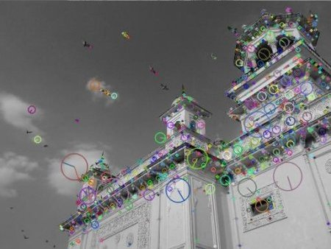
Dynamic Feature Tracking
SIFT and other feature tracking algorithms work well if the object does not “change” too much
The Rubik’s Cube changes its surface features/configurations rapidly
Notes:
This is a specific application of dynamic feature/object tracking. Last week, we’ve seen feature tracking on “static” textures (side of a building, image on a paper, etc) The project aims to track features on a Rubik’s cube that changes the configurations very often.

Slide 4
Technological Approaches
1) Tracking of the Rubik’s Cube
2) Tracking of the hand/fingers
Ideally, we will combine all this information to more accurately track and predict the cube state.

Slide 5
Technological Approaches
1) Tracking of the Rubik’s Cube <- (MVP Focus)
2) Tracking of the hand/fingers
Ideally, we will combine all this information to more accurately track and predict the cube state.

Slide 6
MVP Progress
We have explored 3+ ways of observing the cube configuration. We will only mention the ones that are somewhat promising.
YOLO object detection
OpenCV Canny edge detection, contours, etc
OpenCV color filtering/segmentation

Slide 7
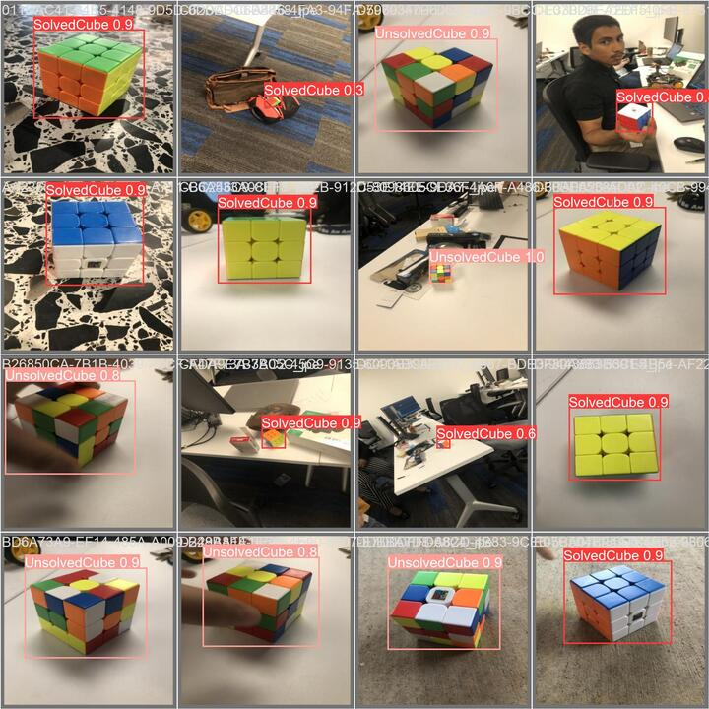
YOLO Object Detection
The model is trained to detect a solved/unsolved Rubik’s cube in a real time.
Right are some examples of detections

Slide 8
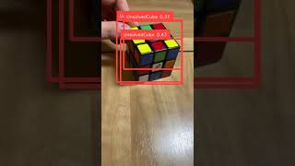

Slide 9
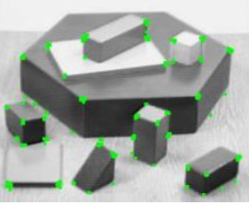
OpenCV Canny Edge Detection, etc
Good edge and corner detection would allow me to fit a virtual model of a cube and easily identify the faces (hence the color configurations)
<- Example of corner detection

Slide 10
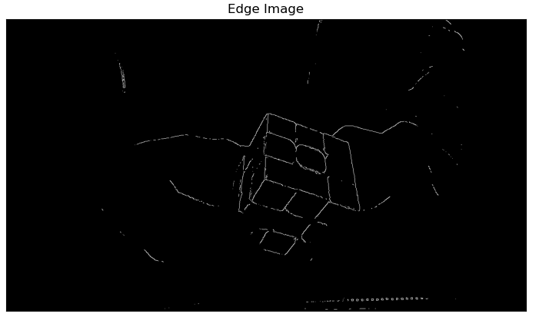
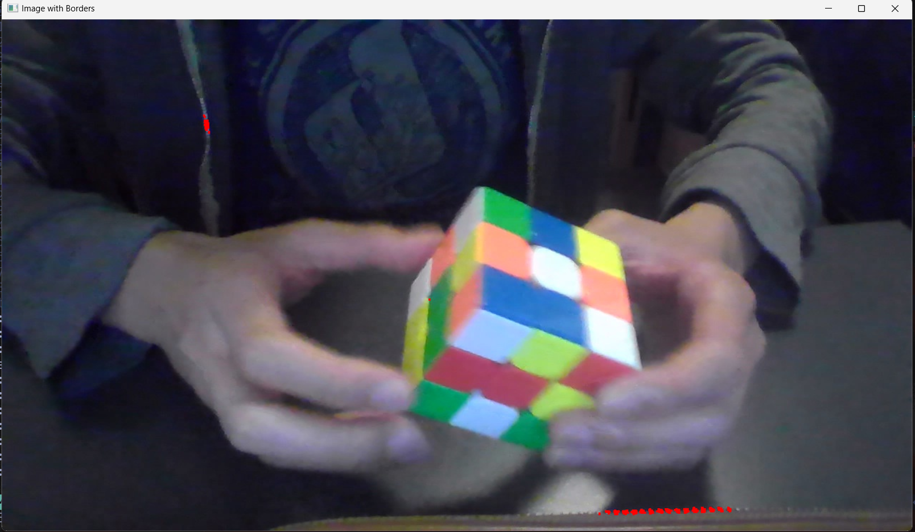
OpenCV Canny Edge Detection, etc
Canny Edge detection ->
<- Harris corner detection

Slide 11
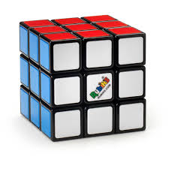
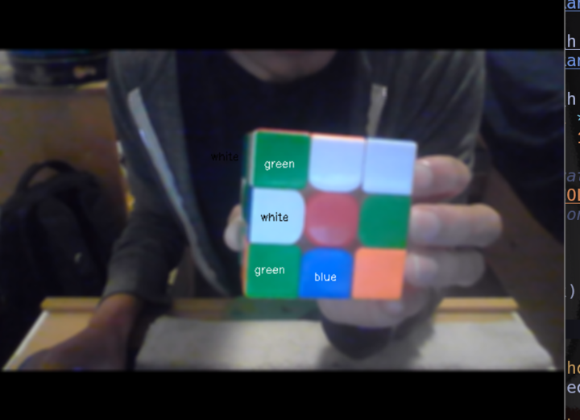
OpenCV color filtering/segmentation
A simple color filtering approach has decent results in identifying some color tiles for a classic Rubik’s cube (top right)
There are errors on stickerless cubes where adjacent tiles with the same color are not identified correctly

Slide 12
OpenCV color filtering/segmentation
A simple color filtering approach has decent results in identifying some color tiles for a classic Rubik’s cube (top right)
There are errors on stickerless cubes where adjacent tiles with the same color are not identified correctly
Worst case: the face is solved and it thinks it’s one color tile.

Slide 13


Slide 14
Plan for the future
Reduce the scope of the project
Offline tracking
Static cube configurations (no additional turns are allowed after scrambling)
Try other OpenCV feature tracking techniques
SIFT
SUFT
Feature Matching
Use YOLO object detection to crop out noise

